Slide 1
DEPARTMENT
OF
EMERGENCY MEDICINE
MAY 11, 2023
https://www.ruem.org/

Slide 2
MISSION STATEMENT
To provide excellent healthcare to EACH patient presenting to the Emergency Room by working as a collaborative team, ensuring all patients are treated like family, receiving compassionate, and evidenced-based care.
VISION STATEMENT
To serve our community as a regional leader in Emergency Healthcare exceeding patient safety, efficient healthcare delivery, specialty care accessibility, while having a vigorous impact to research and academic excellence.
.

Slide 3
2023 ANNUAL STRATEGIC PLAN Presentation to Medical Executive Committee

Slide 4
2022 SWOT ANALYSIS
STRENGTHS
* Leadership
* Teamwork
* Mission
* Academics
* Operations
* Quality
THREATS
* Regulations
* Reimbursements
WEAKNESSES
* Space
* Team Continuity
OPPORTUNITIES
* Disaster Program
* Patient Experience
* Support Services
* Academics
* Sepsis Documentation

Slide 5
DEPARTMENT OF EMERGENCY MEDICINE Provider Organizational Chart
Michael K. Mesisca, DO, M.S., C.C.H.P.-P. Chair/Medical Director/Chief Medical Officer
Sheranda McGee Executive Assistant
Annette Martinez-Lievanos Special Projects Coordinator
Dolores Wright Department Secretary
DIVISIONS and SUB-DIVISIONS
PHYSICIAN
GROUP
SCRIBE PROGRAM
CORRECTIONAL
HEALTH
EXPRESS CARE CLINICS
ADVANCED PROVIDERS
ACADEMIC PROGRAMS
PARTNERS / ATTENDINGS
Thomas F. Minahan, DO Asst. Medical Director
Rodney Koenig, PA-C Asst. Medical Director
Alyssa Weiner, PA-C
Giselle Ludi, PA-C
Site Leads
Thomas F. Minahan, DO
Residency Program Director
Sheranda McGee Program Manager
Nancy Peterson, NP Lead PA
M. Mia Barrozo Admin. Asst.
Corona Community FHC
11 Core Faculty
Michael Mesisca, DO
Fariuz Despujos Harfouche, MD
Korbin haycock, MD
Eugene Hu., MD
Joel Labha, DO
Stephanie Loe, MD
Thomas Minahan, DO
Andrew Pachon, MD
Melanie Randall, MD
Amy Russell, MD
Mark Thomas, DO
14 STAFF PAs
Annette Martinez-Lievanos
Academic Manager
LEAD SCRIBES
Alyssa Cban
Melissa Chan
Karla Montes
Alyssa Kumari
Moreno Valley FHC
RESIDENCY
FELLOWSHIPS
MEDICAL STUDENTS
Riverside Neighborhood FHC
46 SCRIBES
EM Advanced Ultrasonography
NEW Airflight
Amy Russell, MD Clerkship Director
M. Mia Barrozo Residency Coordinator
RESEARCH
CURRENT ROTATIONS
Emergency
Research
Ultrasonography
SITES
RUHS Emergency Room
3 RUHS Clinics
Loma Linda Med Group OB/GYN
DeAnza Orthopaedics
Annette Martinez-Lievanos
Research Coordinator
NEW EMS/Disaster Medicine
Annette Martinez-Lievanos
Student Coordinator
30 Residents
Michael Mesisca, DO
Program Director
EM Physician Assistant
TBD
Assoc. Program Director
Korbin H. Haycock, MD
Program Director
Physician and Physician Assistant Students
Andrew Pachon, MD
Assoc. Program Director
Joel Labha, DO
Program Director
1-2 Fellows
Annette Martinez-Lievanos
Program Coordinator
Annette Martinez-Lievanos
Program Coordinator
6 Fellows
1-2 Fellows

Slide 6
DEPARTMENT OF EMERGENCY MEDICINE Nursing Organizational Chart
Lisa Mackie, RN
Clinical Administrator of Nursing Services II
Maria
DeLeon, RN
ANM
Autumn Martinez, RN
ANM
Stephanie
Dvorak, RN
ANM
Stan Hall, RN
ANM / IP Clinical Disaster Coordinator
Collette Hamilton
OA III
Lori Maddox, RN
ANM /PLN Coordinator / Disaster
Dan Wethy, RN
Point of Care
Autumn
Salazar, RN
PI Coordinator / QI Education
Shalyn
Kernop, RN
Nurse Manager
Quentin Shuster, RN
Point of Care
Primary
Charge Nurse
RN
LVN
MUC
ED TECH
TAP NA
Stock Clerk(s)

Slide 7
LEADERSHIP TEAM

Slide 8
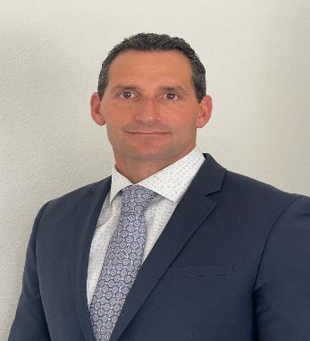
Michael K. Mesisca, DO ., M.S., C.C.H.P.-P.
Chair, Department of Emergency Medicine
Medical Director, Department of Emergency Medicine
Medical Director of Disaster Medicine & Clinical Support Services
Chief Medical Officer, Correctional Health
EMS Fellowship Program Director

Slide 9
Mark E. Thomas, DO Vice Chair Associate Medical Director of Operations
PHYSICIAN LEADERS
Fairuz Despujos Harfouche, MD Assistant Medical Director of Operations Throughput
Patient Experience and SEPSIS
Thomas F. Minahan, DO, FACOEP Director of Education
Residency Program Director
Medical Director, Correctional Health
Joel A. Labha, DO Assistant Residency Program Director PA Fellowship Director Trauma Liaison Psychiatry Liaison
Amy Russell, MD EM Student Clerkship Director EM Stroke Champion
Melanie M. Randall, MD Assistant Medical Director of Quality & Research
Andrew G. Pachon, MD Assistant Medical Director of EMS & Base Station
Assistant Director of EMS and Disaster Medicine
Stephanie Loe, MD Assistant Medical Director of EMS, Disaster & International Medicine
Korbin H. Haycock, MD Assistant Medical Director of Ultrasound & Resuscitation Program Director of Advanced Ultrasonography Fellowship
Kevin Chen, MD Non-EM and Visiting Resident Rotators Scheduling Coordinator
Eugene Hu, MD Ethics Champion
Sarah Malcolm, MD Director of Wellness

Slide 10
NURSING

Slide 11
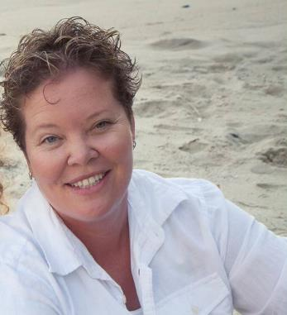
Lisa Mackie, RN
Clinical Director of Nursing II

Slide 12
EMERGENCY ROOM TEAM
Shalyn Kernop Nurse Manager
Maria DeLeon, RN Assistant Nurse Manager
Autumn Martinez, RN Assistant Nurse Manager
Stephanie Dvorak, RN Assistant Nurse Manager
Lori Maddox, BSN, RN, CEN Pre-Hospital Liaison and
Disaster Coordinator
Autumn Salazar, RN Quality and Education Coordinator
Stan Hall, RN In-Patient Disaster Coordinator
Michelle Lemieux, RN Educator
Ashley Young, RN Educator
Jamie Johnson, RN Educator
Maria Arvizu, RN Educator
Dan Wethey, RN Point-Of-Care Lead
Quentin Shuster, RN Point-Of-Care Lead
Richia Davis, LVN Billing
Carlande Gue, LVN Billing
Danielle Mackey, LVN Billing
Collette Hamilton Office Assistant
146 RUHS RN’s
48 Traveling RN’s
16 LVN’s
1 Stock Clerk
9 Medical Unit Clerks
50 TECHS

Slide 13
ADMINISTRATIVE STAFF

Slide 14
OFFICE STAFF
Sheranda McGee, Sr. Practice Administrator
Assistant to Chair/Medical Director
Scribe Manager
Dolores Wright, Department Secretary
Medical Staff Support for Providers
M. Mia Barrozo, B.A.
Residency Coordinator
Practice Administrator for Correctional Health
Annette Martinez-Lievanos, Notary Public
Academic Manager / Special Academic Projects Coordinator
Ultrasonography Advanced Fellowship Coordinator
Research Coordinator / Interim-Student Coordinator
Interim-EMS / Disaster Medicine Coordinator

Slide 15
PHYSICIAN ASSISTANT LEADS
CORRECTIONS HEALTH
EMERGENCY DEPARTMENT
EXPRESS CARES
PHYSICIAN ASSISTANT
FELLOWSHIP
Nancy Peterson, NP
Lead Nurse Practitioner
Alyssa Weiner, PA-C
Lead Physician Assistant
Rodney Koeing, PA-C
Assist. Medical Director
Giselle Ludi, PA-C
Lead Physician Assistant
Alyssa Weiner, PA-C
Lead Physician Assistant
Vivian Acevedo, PA-C
Lead Physician Assistant
Giselle Ludi, PA-C
Lead Physician Assistant
Tiffany Mendoza, PA-C
Lead Physician Assistant

Slide 16
LEAD SCRIBES
Melissa Chan
Lead SCRIBE
Karla Montes
Lead SCRIBE
Alyssa Kumari
Lead SCRIBE
Allyssa Chan
Lead SCRIBE

Slide 17
OPERATIONS

Slide 18
THROUGHPUT PERFORMANCE and CORE MEASURES

Slide 19
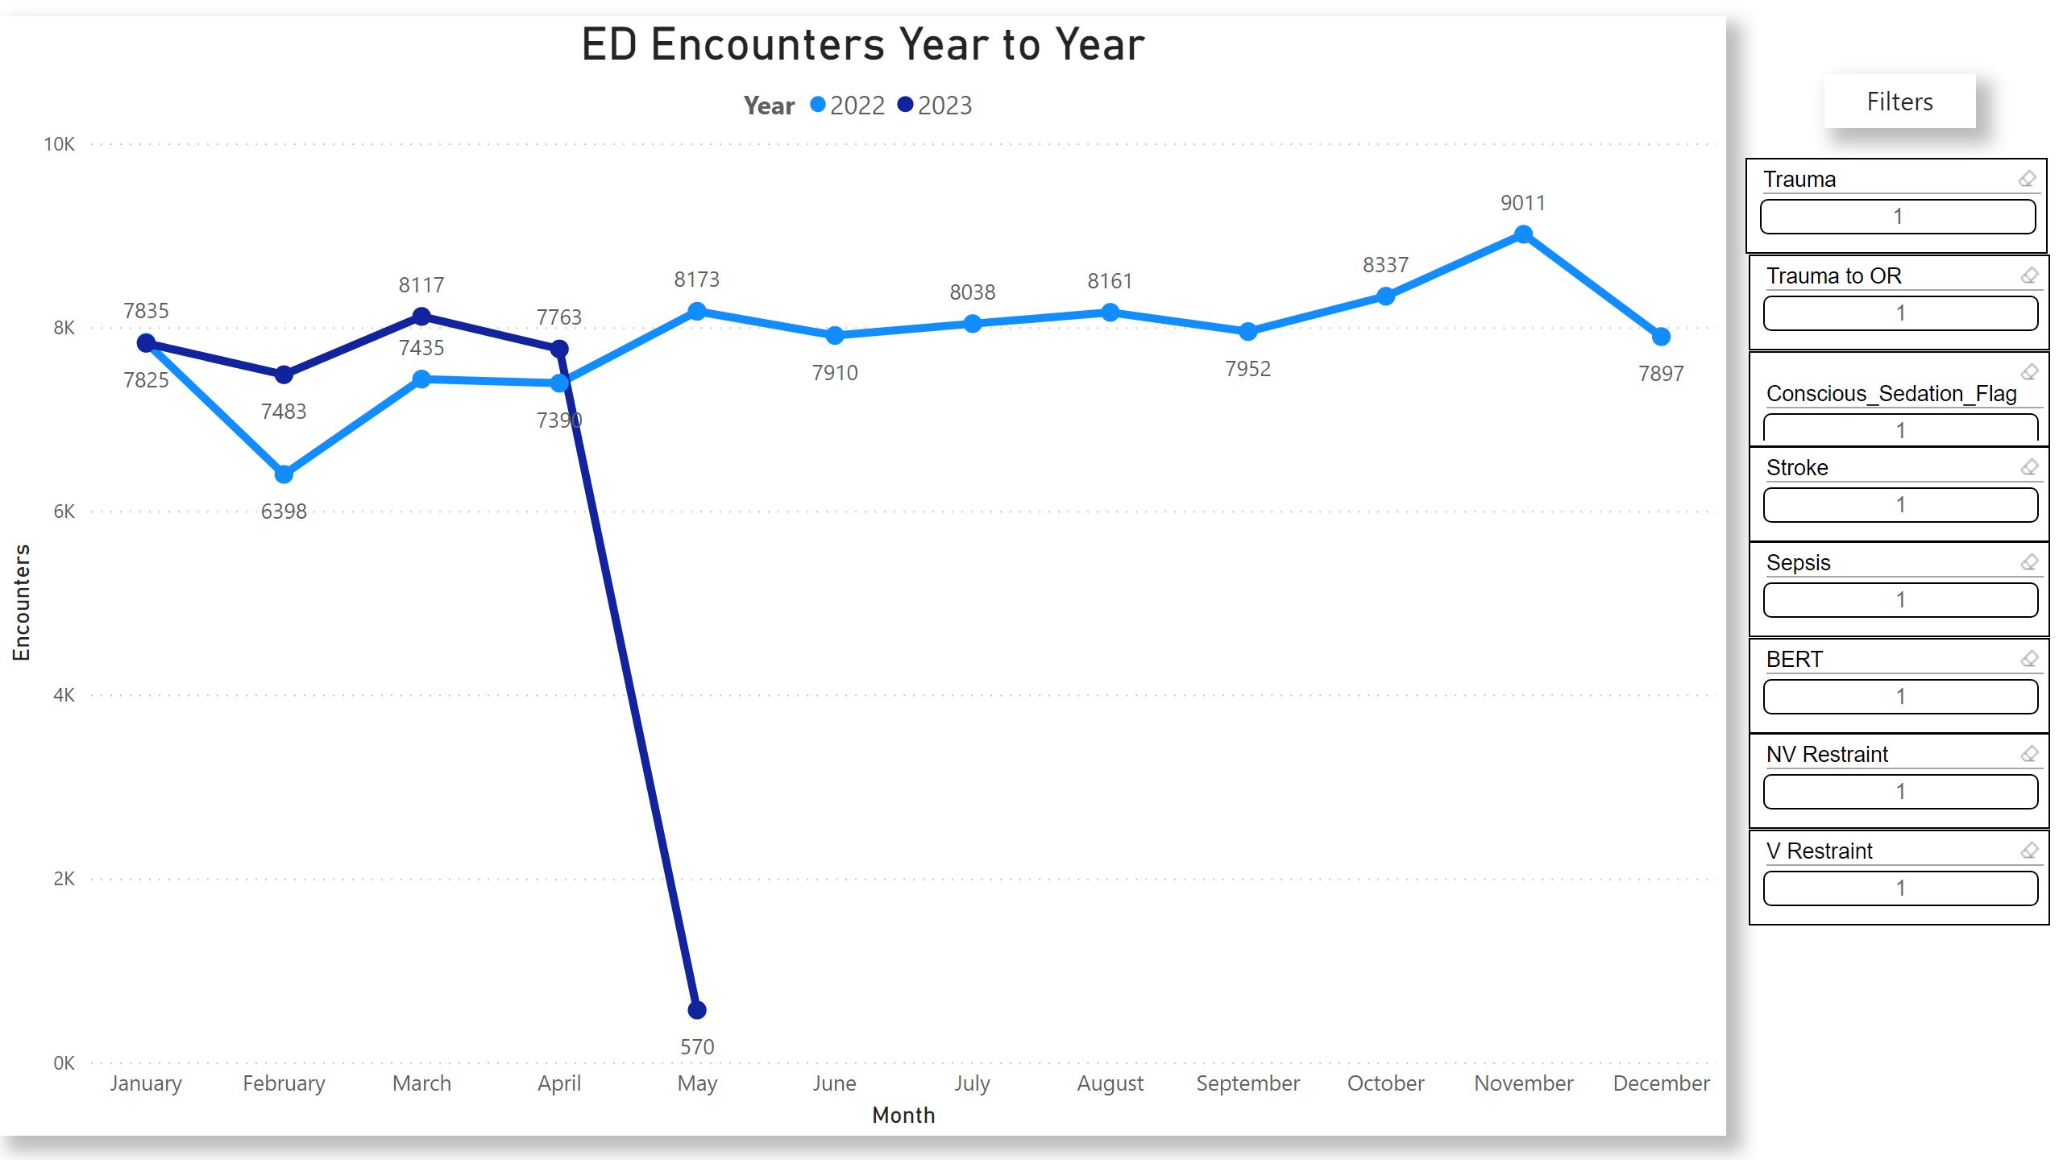
ED ENCOUNTERS 2022

Slide 20
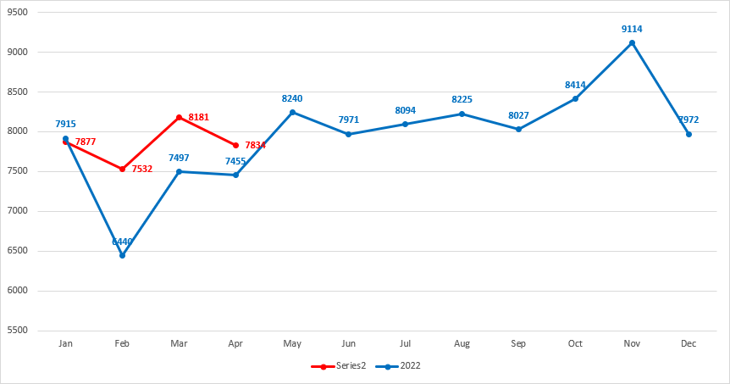
VOLUME 2022 to Current
TOTAL VOLUME: 94,446
AMBULANCES: 22,150

Slide 21
2022
NURSING TRIAGE
8 Mins.
2022
LEFT WITHOUT BEING SEEN
0.3%
GOAL = < 2.5%
2022
ELOPEMENTS
2.5%
GOAL = < 2.5%
2022
TURN-AROUND-TIME-TO-DISCHARGE
222%
GOAL = 180 mins.
2022
TURN-TO-PROVIDER
16 mins.
Maintained < 20 Mins. throughout pandemic

Slide 22
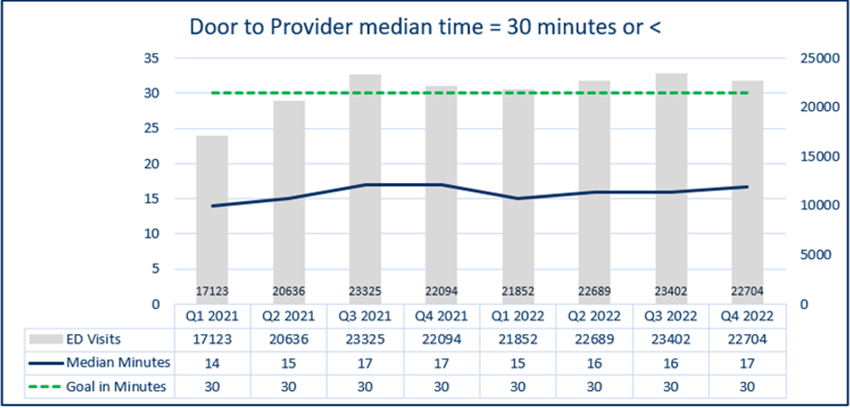
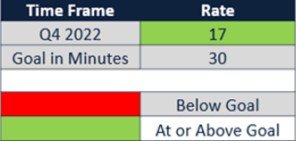
THROUGHPUT PERFORMANCE
Lower is better
Internal Goal was established by the Emergency Department

Slide 23
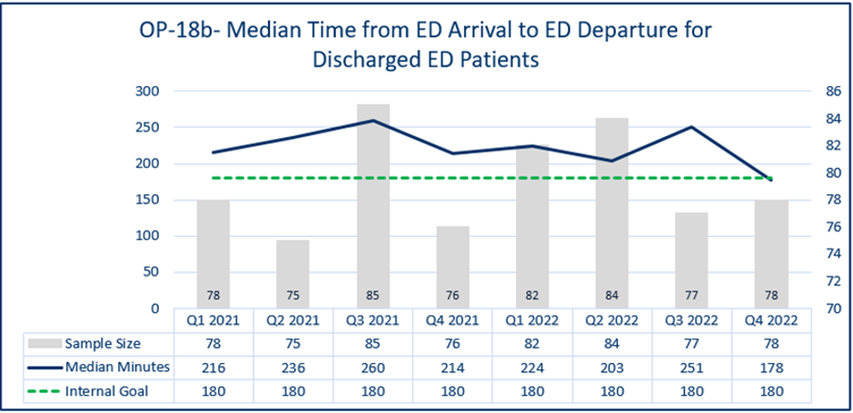
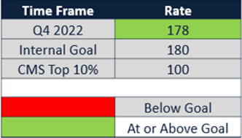
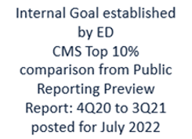
CORE MEASURES
Lower is better
Internal Goal was established by the Emergency Department
CMS TOP 10%
Reporting Preview
Report: 4Q20 to 3Q21
Posted: July 2022

Slide 24
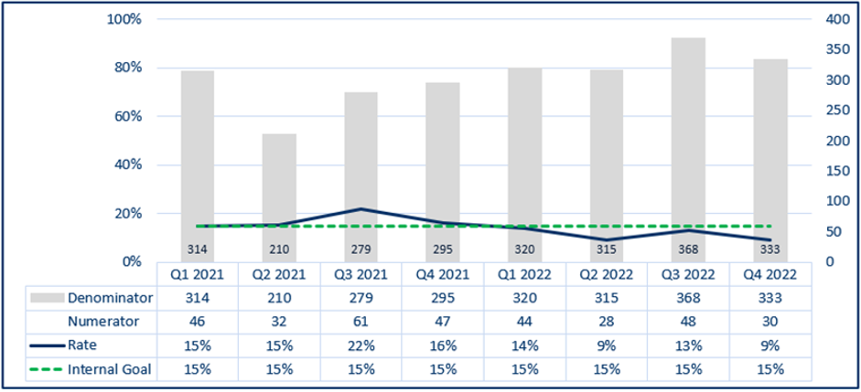
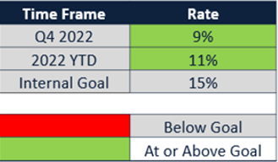
SEPSIS LATE RECOGNITION OF SEPSIS
Lower is better
Goal was established by the SEPSIS Committee

Slide 25
STROKE PERFORMANCE INDICATORS

Slide 26
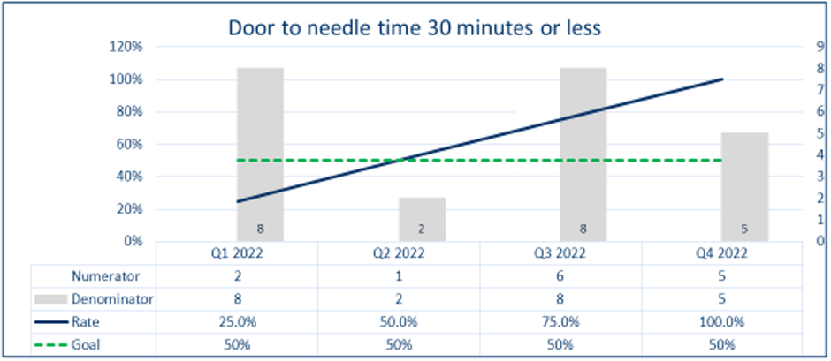
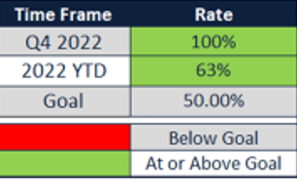
STROKE PEFORMANCE INDICATORS
Higher is better
Goal is set by the Joint Commission, AHA/ASA Clinical Practices

Slide 27
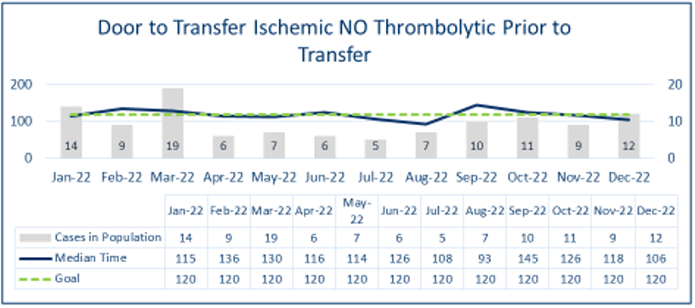
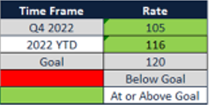
STK OP-1d
NEW MEASURE
Lower is better

Slide 28
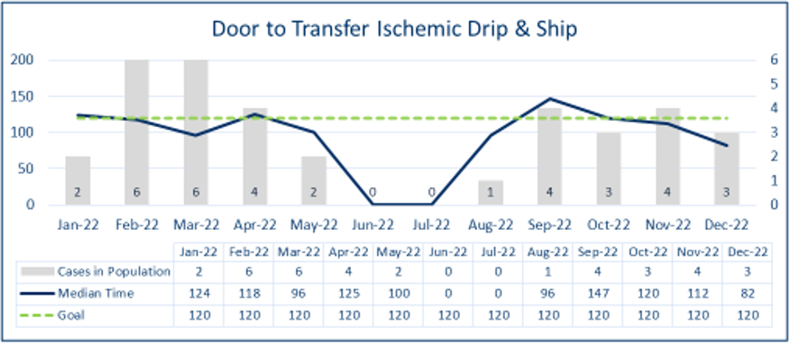
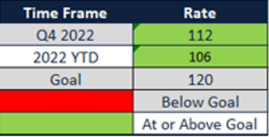
STK OP-1g
NEW MEASURE
Lower is better

Slide 29
EMERGENCY MEDICAL SERVICES

Slide 30
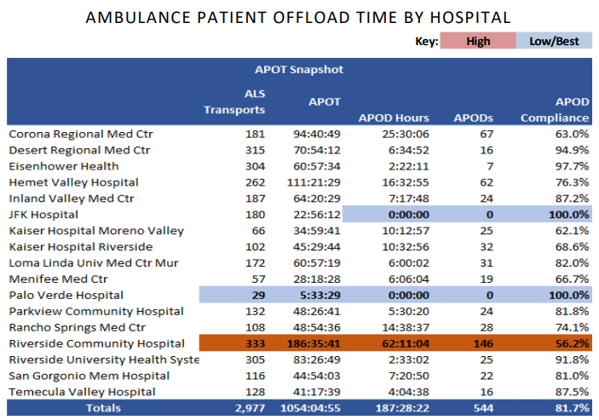
2022

Slide 31
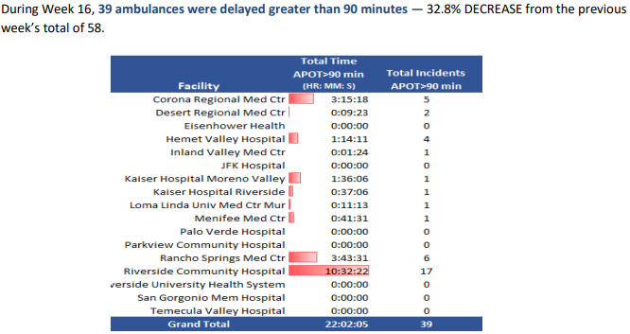
During week 16

Slide 32
LEAN INITIATIVES

Slide 33
QUALITY DASHBOARD
THROUGHPUT
Weekly Operations Leadership Meetings
Triage and Ambulance Daily Data and QA Reviews
RUHS Throughput Committee
Rounding
Lab & Radiology Collaboratives:
Surge & Staffing Initiatives with Administration
CLINICAL PATHWAYS IM, MICU, TRAUMA, EGS, PEDS/PICU, GI, ORTHO, BH​
LAB
POC EXPANSION (POCT BMP and Serum HCG)​
Lab Messenger Rounding
​
PATIENT SATISFACTION​
Provider Care Cards in English & Spanish
Monthly Provider Specific Report/Scores​
Software use for the patient rounding​
Department meetings includes education and educational information​
PXP Event/Collaborative

Slide 34
2022 – 2023 QUALITY INITIATIVES

Slide 35
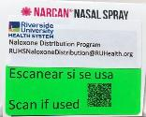
RUHS QUALITY INITIATIVES
IEHP P4P TARGETS Appointments at time of ED Discharge. Alternatives to ED Care.
STROKE: AHA GOLD Plus Medal of Honor Achievement (8 yrs. in a row)
SEPSIS: JC Surveyor, “Best program I have ever seen”. “One of the lowest mortality rates in the country.”
HIV & HEP C SCREENING:
BEHAVIORAL EMERGENCY RESPONSE TEAM: Early Intervention, Safety Measures, Transfer Process
PEDIATRIC FORENSICS COLLABORATIVE
PALLIATIVE CARE:
POLST Evaluations
Care Plan Discussions
ED PC RN
ED ULTRASOUND UTILIZATION AND EXPANSION: Cutting edge resuscitation (Ultrasound and dedicated Resuscitation Team)
FREE NARCAN Distribution Program: RUHS-ER initially received 500 kits and to date
distributed 478 of that batch. A new shipment of 1,000 kits arrived.
YEAR | HIV # of Pts. Tested | HIV + Rate | HEP-C # of Pts. Tested | HEP-C + Rate
2021 | 4,919 | 0.5% | 6,638 | 2.5%
2022 | 9,240 | 0.57% | 9,139 | 2.7%

Slide 36
COMMUNITY HEALTH CENTERS and EXPRESS CARE

Slide 37
LOCATIONS
PATIENT VOLUME BY SITE
Corona Community Health Center
2813 S. Main Street., Corona, CA 92882
2020 (Aug-Dec.) | 2021 | 2022 | 2023
1,613 | 7,465 | 8,870 | 3,459
Main Campus Community Health Center
26600 Cactus Ave., Ste.#300 Moreno Valley, CA 92555
2022 (June-Dec.) | 2023 (Jan-Current)
5,829 | 4,478
NEW
Riverside Neighborhood Health Center
7140 Indiana Ave., Riverside, CA 92504
https://www.ruhealth.org/services/same-day-care

Slide 38
ACADEMICS

Slide 39
RESIDENCY
https://www.ruhsemergency.org/

Slide 40
CORE FACULTY
Michael K. Mesisca, DO, M.S., C.C.H.P.-P.
Residency: Arrowhead Regional Medical Center
Medical School: Western University Health Sciences
Fairuz C. Despujos Harfouche, MD
Residency: Loma Linda Univ. Medical Center
Medical School: University of Nevada
Thomas F. Minahan, DO, FACOEP
Residency: MidWestern-Chicago
Medical School: Western University Health Sciences
Korbin H. Haycock, MD
Residency: Loma Linda Univ. Medical Center
Medical School: Loma Linda Univ. Medical Center
Andrew G. Pachon, MD
Residency: Loma Linda Univ. Medical Center
Medical School: Univ. of Illinois at Chicago, COM
Eugene W. C. Hu, MD
Residency: Loma Linda Univ. Medical Center
Medical School: Louisiana State Univ. Health Sci. Ctr.
Melanie M. Randall, MD
Residency: Loma Linda Univ. Medical Center
Medical School: Loma Linda Univ. Medical Center
Joel A. Labha, DO
Residency: Arrowhead Regional Medical Center
Medical School: Western University Health Sciences
Amy E. Russell, MD
Residency: Loma Linda Univ. Medical Center
Medical School: Temple University
Stephanie A. Loe, MD
Residency: Loma Linda Univ. Medical Center
Medical School: Wayne State University
Mark E. Thomas, DO
Residency: Loma Linda Univ. Medical Center
Medical School: Western University Health Sciences

Slide 41
2022 – 2023 RESIDENTS
PGY-I
Lisa Blakely, MD
LLUMC
Darius Buenaventura, DO
Western COMP
Eric Chai, DO
Touro Univ. COM Nevada
Anthony Dahi, DO
Touro Univ. COM Nevada
Natalie Fenske, DO
Western COMP
James Miller, DO
Touro Univ. COM Nevada
Miles Ondoy, DO
AZ College of Osteopathic Medicine of MidWestern Univ.
Mariam Saleh, DO
AT Stills Univ. SOMA
PGY-II
Salomon Alvarado, DO
Western COMP
Arjun Bakshi, DO
Western COMP
Tristen Burt, DO
Western COMP
Scott Cruise, DO
Western COMP
Moses Lee, DO
Western COMP
Ruben Marchosky, DO
Western COMP
Michael Millard, DO
Western COMP
Christopher Pann, DO
Western COMP
Daniel Roth, MD
Drexel University
Nikolaos Sarantopoulos, DO
Western COMP
PGY-III
Umron Alkotob, DO
AT Stills Univ. SOMA
Kevin Dales, DO
Touro Univ. COM CA
Alexander Gau, DO
Western COMP
Charles Lewsadder, DO
Kansas City Univ. of Med. & BioSciences College of Osteopathic
Jackson Lu, DO
Western COMP
Raj Patel, DO
Touro Univ. COM CA
Carl Rhodes, DO
Chicago College of Osteopathic
Oscar Salaiz, DO
Western COMP
Jonathan Tom, DO
Western COMP

Slide 42
HIGHLIGHTS
2023 MATCH RESULTS
SPOTS OFFERED: 10 MATCHED POSITIONS: 8 SOAP: 2
MD: 1 DO: 9 MEN: 7 WOMEN: 3 PRIOR SCRIBE: 2
We are PROUD to announce that one of our top academic objectives has been met this academic year. Inclusion of DIVERSITY for recruitment of women into our program has been a successful campaign.
Our academic programs are dedicated to continually strive to ensure that all of our programs within the Emergency Medicine Department be diverse not only with ethnicity but to include gender.
CALMEDFORCE GRANT
With CMF Grant the Residency program purchased three ultrasound machines for the education of residents and learners in the ER setting.
The grant has also been used to off-set resident conference attendance, licensures, guest lecturer, subscriptions, retreat, meals for lectures and other items that benefit the residency educational program.

Slide 43
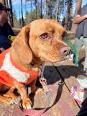
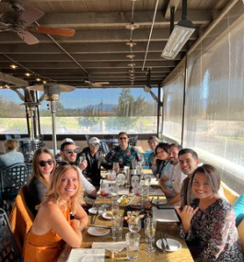
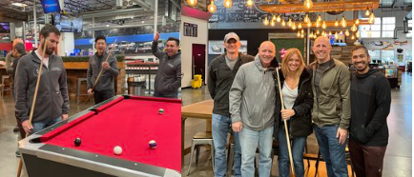
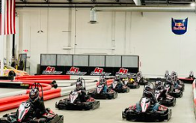
2022 WELLNESS EVENTS

Slide 44
DIVISION OF RESEARCH

Slide 45
PROJECTS
Abstracts/Articles/Paper/Posters/Publications
NEW
Adenosine Safety in the Setting of SVF
Post Transfusion CBC Validity
Emergency Management of Obstructive Uropathy and Complex Urinary Tract Infection
The Effect of gravity-induced pre-load change on the venous excess ultrasound (VExUS) score internal jugular vein Doppler in healthy volunteers
EDITORIAL SERVICES | NATIONAL/REGIONAL/LOCAL PRESENTATIONS | PEER REVIEWED PUBLICATIONS
1 | 8 | 4
SCHOLARLY ACTIVITIES | NATIONAL/REGIONAL/LOCAL PRESENTATIONS | PEER REVIEWED PUBLICATIONS
2 Book Chapters | 4 International Lectures | 7 National Lectures
11 Regional Lectures | 4 Peer Reviewed Articles | 10 Reviewed Publications
Various lectures to Medical Schools, RUHS EM and PA Lecture Series, EM Clubs, EMS; Presentations to Riverside Co. Board of Supervisors.

Slide 46
DIVISION OF EMERGENCY MEDICINE ADVANCED ULTRASONOGRAPHY FELLOWSHIP
NEW

Slide 47
ACCREDITATION
Accredited by the Emergency Ultrasound Fellowship Accreditation Council (EUFAC)
Program Director – Korbin H. Haycock, MD
Program Coordinator – Annette Martinez-Lievanos
Approved by RUHS 2023
EUFAC accreditation was received March 1, 2023
Joining MATCH June 2023
Interviews start August 2023
First class start date tent. on July 1, 2024
1- 2 Fellows per year
Excellent EM Resident recruiting tool (Allows a great opportunity to fill residency program)

Slide 48
DIVISION OF EM PA/NP FELLOWSHIP
https://www.ruem.org/pa-fellows

Slide 49
PROGRAM DETAILS
This is a 12.5 month fellowship post-graduate training focused on Emergency Medicine with emphasis on safely managing ESI levels
II-V, efficiency, and quality charting​
.
RUHS has had 26 fellows graduate from program to date​
Fellows rotate on the following services
Emergency Medicine 11 months
Internal Medicine for 2 weeks
Intensive Care Unit 2 weeks
Corrections​ 1 week
Elective options Opthalmology, Orthopaedic, Anesthesia, and may repeat ICU
Fellows attend weekly lectures and attend monthly US training​ by Dr. Haycock
After graduation​
They become Staff PAs at RUHS or at a local hospital/institution

Slide 50
STUDENTS & NON-EM RESIDENTS

Slide 51
STUDENTS
We have added NEW rotations to our Student Clerkship. We now offer Ultrasonography, Research and pending EMS.
Below are the list of schools, disciplines and rotators from each site that visited our Emergency Room.
School | Discipline | Active Rotations
A.T. Still University - School of Osteopathic Medicine in Arizona (SOMA) | Doctor of Osteopathic Medicine (D.O.) | 1
California Baptist University - Physician Assistant Studies Program | Physician Assistant (P.A.) | 10
College of Saint Mary - Physician Assistant Program | Physician Assistant (P.A.) | 1
Des Moines University - College of Osteopathic Medicine | Doctor of Osteopathic Medicine (D.O.) | 3
Idaho College of Osteopathic Medicine | Doctor of Osteopathic Medicine (D.O.) | 1
Kansas City University | Doctor of Osteopathic Medicine (D.O.) | 1
Lake Erie College of Osteopathic Medicine | Doctor of Osteopathic Medicine (D.O.) | 1
Loma Linda University School of Allied Health Professions, Department of Physician Assistant Sciences | Physician Assistant (P.A.) | 8
Loma Linda University School of Medicine - Dept of Medicine | Doctor of Medicine (M.D.) | 1
Medical University of the Americas | Doctor of Medicine (M.D.) | 1
Michigan State University College of Human Medicine | Doctor of Osteopathic Medicine (D.O.) | 1
Midwestern University - Arizona College of Osteopathic Medicine | Doctor of Osteopathic Medicine (D.O.) | 2
Nova Southeastern University; Dr. Kiran C. Patel College of Osteopathic Medicine | Doctor of Osteopathic Medicine (D.O.) | 1
Philadelphia College of Osteopathic Medicine | Doctor of Osteopathic Medicine (D.O.) | 1
River Plate Adventist University | Doctor of Medicine (M.D.) | 1
Rocky Vista University | Doctor of Osteopathic Medicine (D.O.) | 3
Sackler School of Medicine | Doctor of Medicine (M.D.) | 1
St. George's University | Doctor of Medicine (M.D.) | 1
Touro University Nevada - College of Osteopathic Medicine | Doctor of Osteopathic Medicine (D.O.) | 5
Tufts University School of Medicine | Doctor of Medicine (M.D.) | 1
Universidad Autonoma de Guadalajara | Doctor of Medicine (M.D.) | 1
University of California Riverside School of Medicine | Doctor of Medicine (M.D.) | 9
University of South Alabama | Nurse Practitioner (N.P.) | 1
University of South Alabama College of Nursing | Nurse Practitioner (N.P.) | 1
Western University of Health Sciences | Doctor of Osteopathic Medicine (D.O.) | 1
Western University of Health Sciences, COMP | Doctor of Osteopathic Medicine (D.O.) | 22
Western University of Health Sciences, COMP-NW | Doctor of Osteopathic Medicine (D.O.) | 1
Western University of Health Sciences/CHS | Physician Assistant (P.A.) | 12
William Carey College of Osteopathic Medicine | Doctor of Osteopathic Medicine (D.O.) | 1
Yale School of Medicine- Physician Assistant Online Program | Physician Assistant (P.A.) | 1
 |  | 95

Slide 52
NON-EM & NON-RUHS RESIDENT ROTATORS
INSTITUTION | DEPARTMENT | PGY LEVEL | LENGTH OF ROTATION
RUHS | EM | PGY-I | 7.75 months
RUHS | EM | PGY-II | 9 months
RUHS | Anesthesia | PGY-I | 1 month
RUHS | Neurology | PGY-I | 1 month
RUHS | Neurosurgery | PGY-I | 1 month
RUHS | Orthopaedics | PGY-I | 1 month
RUHS | Radiology | PGY-I | 1 month
RUHS | Internal Medicine | PGY-II | 2 weeks
RUHS | Family Medicine | PGY-II | 1 month (four x one-week blocks)
LLUMC | Family Medicine | PGY-II | 1 month
LLUMC | Emergency Medicine | PGY-I | 1 month
LLUMC | Emergency Medicine | PGY-II | 1 or 2 months
LLUMC | Emergency Medicine | PGY-III | 1 or 2 months

Slide 53
SCRIBE PROGRAM

Slide 54
PROGRAM DETAILS
Scribes provide their services throughout RUHS in various departments but the Emergency Department is their home base.
Scribe Manager: Sheranda McGee
4 Lead SCRIBES
46+ SCRIBES for all programs
LOCATION | DEPARTMENT | TOTAL
RUHS | Emergency Medicine | 46 +
RUHS | OB/GYN (Loma Linda Med. Group) | 5
RUHS | Orthopaedics (DeAnza Group) | 8
RUHS | Community Health Clinic (Main Campus) | 8
RUHS | Corona Community Health Care Ctr. | 8

Slide 55
COMING SOON…
Emergency Medical Services/Disaster Medicine Fellowship
Air Flight Program
Additional student rotations to be added
EMS

Slide 56
SPECIAL TEAMS

Slide 57
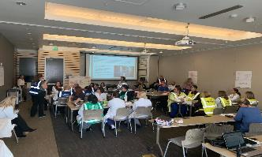
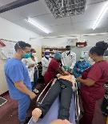
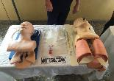
INTERNATIONAL MEDICINE
DISASTER MEDICINE
A Center of Hospital Disaster Preparedness
2019 Guatemala
2021 Tanzania and Kenya
2022 Nigeria
Team of 20 (12 from RUHS)
Participation is voluntary
Supported 2 hospitals with patient care and education in surgical & primary care
Collaborative Multi-Disciplinary Engagement 2022 Training/Exercises
4/2022: MCI Training/Workshop​
7/2022: Active Shooter Tabletop​
9/2022: Full-scale Active Shooter Exercise​
11/2022: Hazmat/Decon Staff Training for
12/2022: MARB Functional Exercise​

Slide 58
HIGHLIGHTS and HONORABLE MENTIONS

Slide 59
GOALS
2022
The following goals were met:
Improved patient experience – Increased by 10%
Improved SEPSIS bundle compliance – Increased by 10%
Continued support of the growth of PEDS and PICU volume
Research and scholarly activity goals reached
Enhanced the efforts of the Clinical Disaster Team
Expanded the activities of the International Medicine Team
Improve diversity and inclusion in all academic programs
2023
Improve STEMI workflows
Door-to-Treatment (TX) < 60 mins.
Decrease elopements below 2%
Decrease Turn-Around-Time-To-Discharge (TAT-D) below 200 mins.

Slide 60
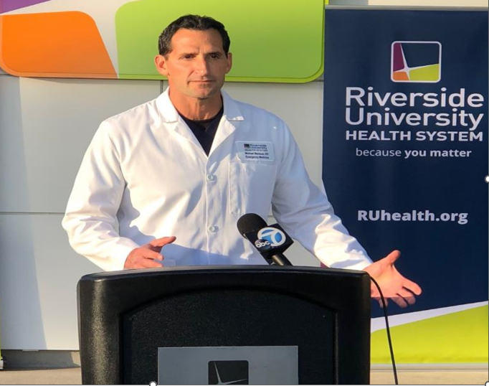
HONORABLE MENTIONS
Recipient of
Riverside University Health System
2022 Culture of Caring Award
Recipient of the 2022 VITUITY Distinguished Service Award
Regional Healthcare Surge Response
&
State Transfer Center

Slide 61
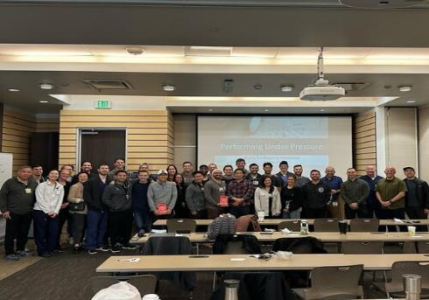
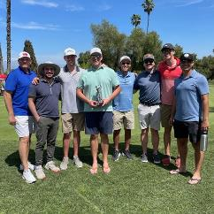
If you want to go fast, go alone. If you want to go far, you need a team.
- John Wooden
https://www.ruem.org/
https://www.ruhsemergency.org/

